Slide 1
STATUS OF UGANDA’S DEBT
Ministry of Finance, Planning & Economic Development
March, 2023

Slide 2
Outline
Definitions.
Key Macroeconomic Indicators
Uganda’s public debt portfolio
Debt to GDP projections
Risk of debt distress in other countries
Debt service as a share of revenues
Conclusion

Slide 3
What is Debt Sustainability
The analysis of debt sustainability is hinged on two key concepts:
Solvency: Future incomes are sufficient to meet future expenditures and pay off current debt.
Liquidity: Available liquid assets (e.g. cash) are sufficient to meet maturing obligations.
Stable / declining Debt/GDP is sufficient to ensure solvency
Debt sustainability is closely associated with debt distress.
Debt service default (i.e. payment arrears)
Emergency re-structuring discussions with creditors

Slide 4
Real GDP Trends
Source: Uganda Bureau of Statistics; Ministry of Finance, Planning & Economic Development

Slide 5
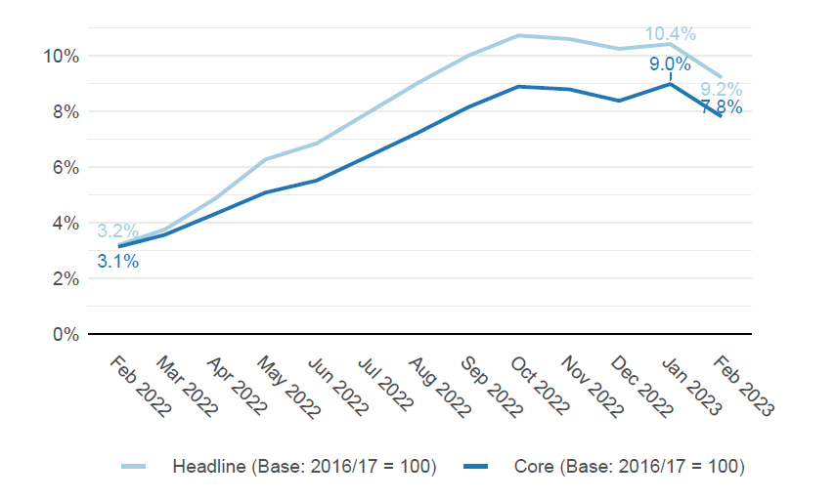
Inflation Trends
Source: Uganda Bureau of Statistics

Slide 6
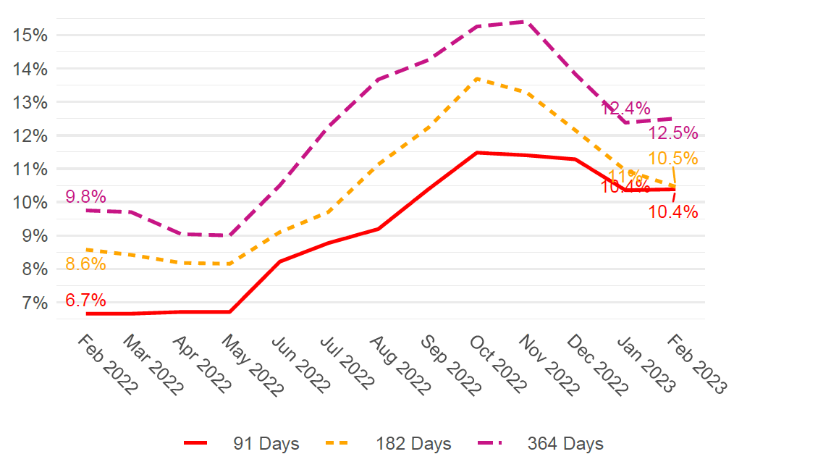
Yields on Treasury Bills
Source: Bank of Uganda

Slide 7
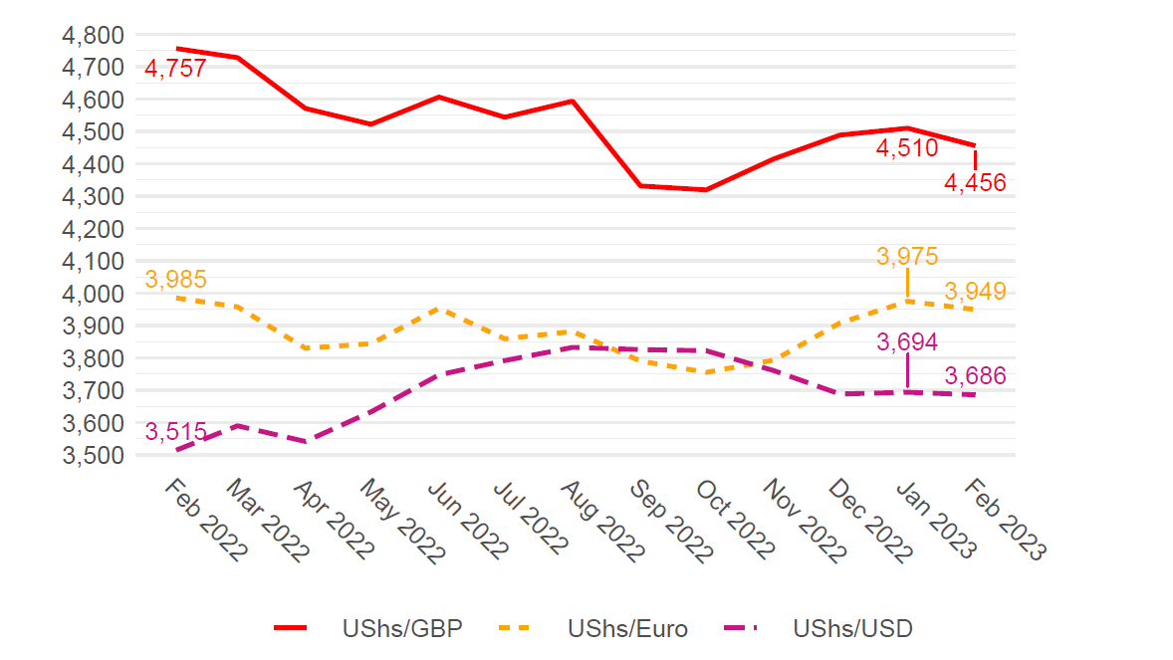
Exchange Rate Trends
Source: Bank of Uganda

Slide 8
Depreciation vs USD (Selected EAC Currencies)
No: | Country | January 2020 | January 2023 | Depreciation
1 | Uganda | 3,680.7 | 3,693.6 | 0.35%
2 | Tanzania | 2,300 | 2,309.1 | 0.40%
3 | Rwanda | 924.4 | 1,076.6 | 16.5%
4 | Kenya | 101.1 | 123.9 | 22.5%
Source: Bank of Uganda

Slide 9
Exports of Goods and Services (USD Millions)
Source: Bank of Uganda [BoP - 6th Edition of the Manual]

Slide 10
Remittances (USD Millions)
Source: Bank of Uganda [BoP - 6th Edition of the Manual]

Slide 11
FDI Inflows (USD Millions)
Source: Bank of Uganda [BoP - 6th Edition of the Manual]

Slide 12
Tourism Inflows (USD Millions)
Source: Bank of Uganda [BoP - 6th Edition of the Manual]

Slide 13
Debt Portfolio
YEAR | FY 2020/21 | FY 2021/22
Domestic Debt (USD, Bn) | 7.16 | 8.16
External Debt (USD, Bn) | 12.39 | 12.82
Total Debt (USD, Bn) | 19.54 | 20.99
Nominal Debt / GDP | 46.9% | 48.4%
Source: Ministry of Finance, Planning & Economic Development

Slide 14
EVOLUTION OF DEBT
Source: Ministry of Finance, Planning & Economic Development

Slide 15
Debt / GDP (SSA)
Source: MOFPED for Uganda; IMF WEO (October 2022) for the others

Slide 16
Share of External Debt by Creditor
Key
High
Low
Source: Ministry of Finance, Planning & Economic Development

Slide 17
Commercial / External Debt (EAC)
Uganda | 10.4%
Rwanda | 13.0%
Kenya | 26.6%
Tanzania | 31.8%
Source: MOFPED for Uganda; IMF/WB Debt Sustainability Analysis (DSA) reports for others

Slide 18
Debt To GDP (%): DSA vs CFR
 | 2021/22 | 2022/23 | 2023/24 | 2024/25 | 2025/26
DSA Projection | 48.4 | 47.6 | 46.1 | 45.2 | 43.7
Charter Target | 52.7 | 53.1 | 52.4 | 51.2 | 49.3
Source: Ministry of Finance, Planning & Economic Development

Slide 19
Reasons for Medium Term Reduction in Debt
Economic recovery (real GDP growth to reach 7% in the medium term)
Enhanced domestic revenue mobilization, hinged on implementation of the Domestic Revenue Mobilization Strategy.
Careful expenditure management, including reducing less productive expenditure, e.g. on travel abroad.
Changing the debt profile (reducing domestic debt to crowd in the private sector and reducing costly external commercial financing)

Slide 20
RISK RATINGS USING THE LIC DSA (AFRICA)

Slide 21
IMF / World Bank Risk Ratings for African LICs
RISK RATING | COUNTRIES
Low Risk of Debt Distress | NONE
Moderate Risk of Debt Distress | Benin, Burkina Faso, Cape Verde, DRC, Ivory Coast, Guinea, Lesotho, Liberia, Madagascar, Mali, Niger, Rwanda, Senegal, Tanzania, Togo, Uganda
High Risk of Debt Distress | Burundi, Cameroon, CAR, Chad, Djibouti, Ethiopia, Gambia, Guinea-Bissau, Ghana, Kenya, Malawi, Sierra Leon, South Sudan
In Debt Distress | Rep of Congo, Mozambique, Somalia, Sudan, Zambia, Zimbabwe

Slide 22
Debt Service / Revenue
Source: Ministry of Finance, Planning & Economic Development

Slide 23
Debt Service to Revenue Uganda – Kenya Comparison

Slide 24
Conclusions
The Ugandan economy has shown resilience in the face of strong external and internal headwinds.
Public debt remains sustainable in the medium to long term, but the risk rating has declined from “Low” to “Moderate”.
The debt/GDP ratio remains one of the lowest in the region, and is projected to decline in the medium term.
There has been an increase in expensive external commercial and domestic borrowing. Government is taking steps to address this.
Government will pursue a strategy of fiscal consolidation in the medium term, underpinned by improved revenue mobilization and reduction in less productive expenditure.

Slide 25
THANK YOU FOR LISTENING

